Slide 1
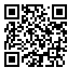
Adv. Biopharmaceutics
Dr. Mohammed Sabbar
College Of Pharmacy - Basrah
3rd Oct. 2018
http://bit.do/ex2aD

Slide 2
For these reasons, a weak acid (such as salicylic acid) will be rapidly absorbed from the stomach (pH 1.2), whereas a weak base (such as quinidine) will be poorly absorbed from the stomach.

Slide 3
Carrier-Mediated Transport
Active transport:
Many drugs are absorbed by these carriers because of the structural similarity to natural substrates
Which is carrier mediated transport that needs energy and carriers ( so the rate is depend on the percent of saturation of the carriers).

Slide 4
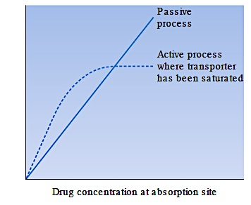
Example: L-Dopa, Penicillin’s, cephalosporin’s (called windows absorption).

Slide 5
Facilitated diffusion:
Many drugs are absorbed by these carriers because of the structural similarity to natural substrates
It needs carriers, but the deriving force is the concentration gradient across the membrane. it represent the percent that specific for metabolites in GIT, kidney, gall bladder.

Slide 6
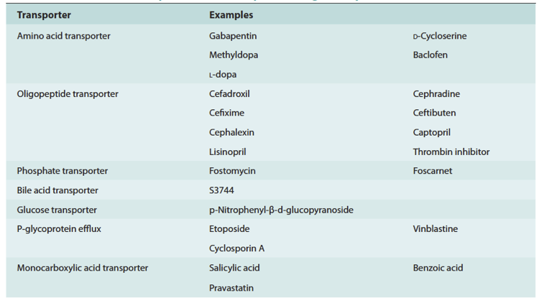

Slide 7
Pinocytosis (Vesicular Transport):
It is very limited for proteins like vaccines by engulfment by the epithelial cells.
Example: Sabino porio vaccines ( for poliomyelitis)
Note: it is the only mechanism in which drug absorbed not to be in aqueous solution.

Slide 8
Ion pair:
It is the mechanism that explains how ionic drugs like quaternary ammonium compounds and tetracycline’s are absorbed. They are present in ionic state along entire GIT (pH) and they are too lipid insoluble. They are interact with endogenous organic ions of opposite charge (p-glycoproteins).
Pores Mechanism:
It is also known as convective mechanism. It is for small molecules (water, urea, and many ions Na, K, Li. and sugars) are able to cross cell membranes rapidly, as if the membrane contained channels or pores. Although such pores have never been directly observed by microscopy, the model of drug permeation through aqueous pores is used to explain renal excretion of drugs and the uptake of drugs into the liver.

Slide 9
Other name of mechanisms (terminology)
Paracellular diffusion
Paracellular diffusion enhanced by modulators of tight junctions.
Transcellular passive diffusion (intracellular metabolites)
Carrier mediated transcellular transport.
Transcellular diffusion modified by an apically polarized efflux mechanism (like ion-pair)
Transcellular vesicular transcytosis (like pinocytosis).

Slide 10
Thank you

